Slide 1
CAPSTONE PROJECT
PROJECT TITLE
Presented By: Abinesh Vibin F
Student Name : Abinesh Vibin F
College Name & Department : Loyola- ICAM College of Engineering and Technology & IT

Slide 2
OUTLINE
Problem Statement
Technology used
Wow factor
End users
Result
Conclusion
Git-hub Link
Future scope

Slide 3
PROBLEM STATEMENT
Develop a technique to enhance image security.
Focus on hiding text messages within image pixels.
Prioritize secure message retrieval with a passcode. Create a user-friendly encryption and decryption process.
Ensure compatibility and efficiency in the algorithm's performance."

Slide 4
TECHNOLOGY USED
Core Technologies: OpenCV (cv2): A powerful Python library for image processing. It's the heart of your steganography, handling image reading, writing, and pixel manipulation. Python: The programming language you've chosen. It's known for its readability and extensive libraries, making it great for tasks like this.

Slide 5
WOW FACTOR:
Core Functionality:
Encryption: The code encrypts a secret message within an image using a simple technique. It iterates through the pixels of the image, modifying the least significant bits of the pixel values to store the ASCII values of the characters in the message.
Why it's not unique: This is a standard and basic approach to image steganography. Many similar projects use the same technique.
Decryption: The code decrypts a secret message from an encrypted image using a passcode. If the correct passcode is provided, the code extracts the ASCII values from the modified pixels and converts them back into characters to reveal the original message.
Why it's not unique: This is the standard decryption method for this type of encryption.
Lack of Unique Features:

Slide 6
The code doesn't incorporate any advanced or unique features that would make it stand out. It uses a straightforward encryption and decryption method without any additional layers of security or complexity. Here are some potential areas where the project could have introduced unique features:
Advanced Encryption Algorithms: The code could have used more sophisticated encryption algorithms to make it more difficult to detect and decrypt the hidden message.
Error Correction: The code could have incorporated error correction techniques to ensure that the message can be recovered even if the image is slightly corrupted.
Data Compression: The code could have compressed the message before encryption to reduce the amount of space it occupies in the image.
Steganalysis Resistance: The code could have included techniques to make it more difficult to detect the presence of a hidden
message using steganalysis tools.

Slide 7
END USERS
The "end users" of the project are the people who will be using the software. It is important to consider the end users throughout the entire software development process, from the initial design to the final testing and deployment. By understanding the end users and what they need, you can create a successful software project.

Slide 8
RESULTS

Slide 9
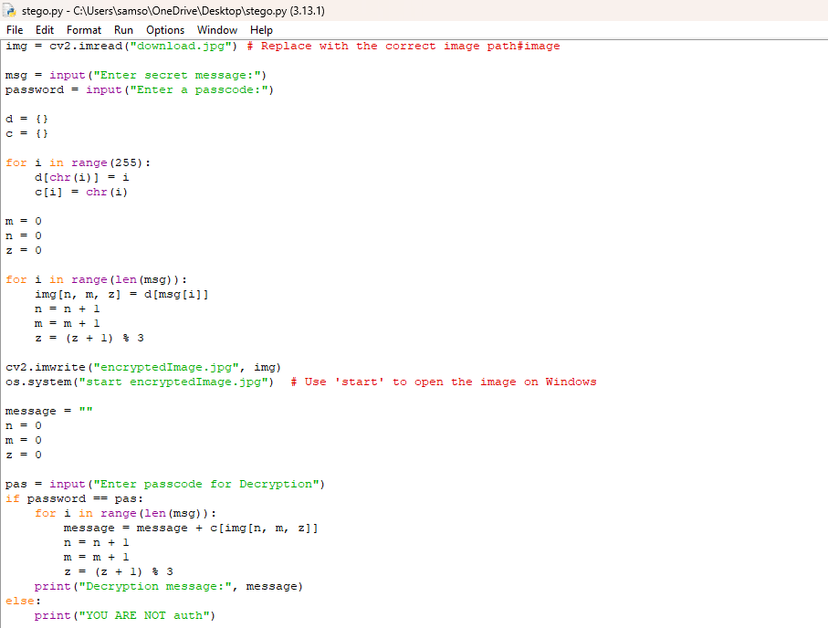

Slide 10
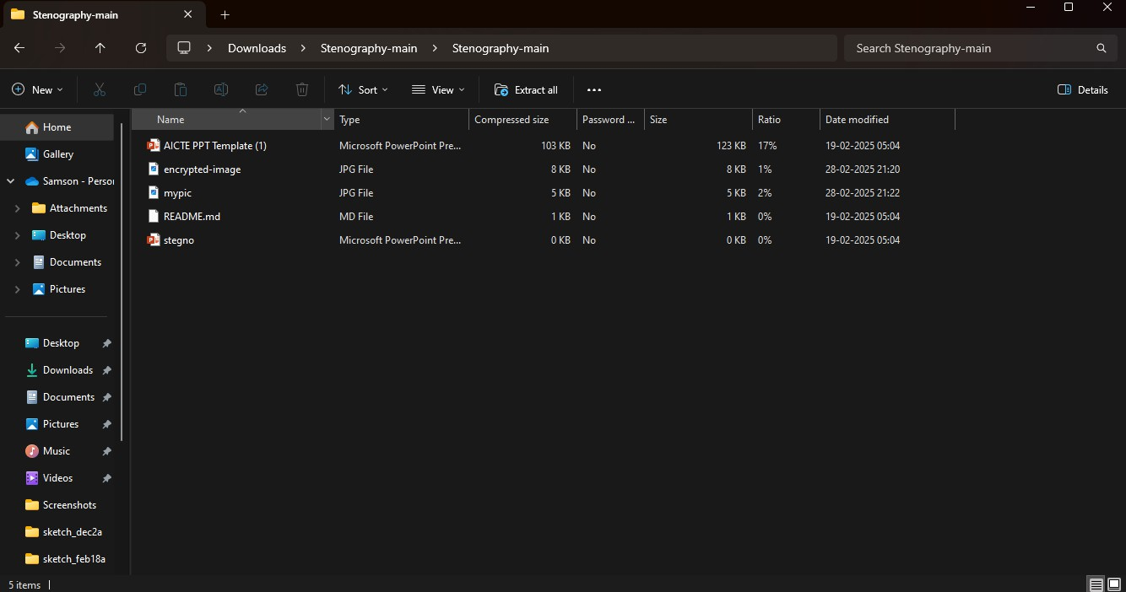

Slide 11
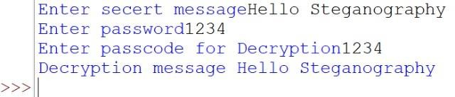

Slide 12
CONCLUSION
Develop a technique to enhance image security.
Focus on hiding text messages within image pixels. Prioritize secure message retrieval with a passcode. Create a user-friendly encryption and decryption process.
Ensure compatibility and efficiency in the algorithm's performance."

Slide 13
GITHUB LINK
https://github.com/vibin677/MYPROJECT/tree/main

Slide 14
FUTURE SCOPE(OPTIONAL)

Slide 15
THANK YOU

